Slide 1
Touch For Food February 26 Meeting
CloudNine

Slide 2
Agenda
Announcements
Retrospective Sprint 8
Scrum updates w/ presentations
General Issues
SAD updates
Goals
Schedule
Questions?

Slide 3
Announcements
Make sure to close your tasks on Jira as you go (Test Report is not accurate)

Slide 4
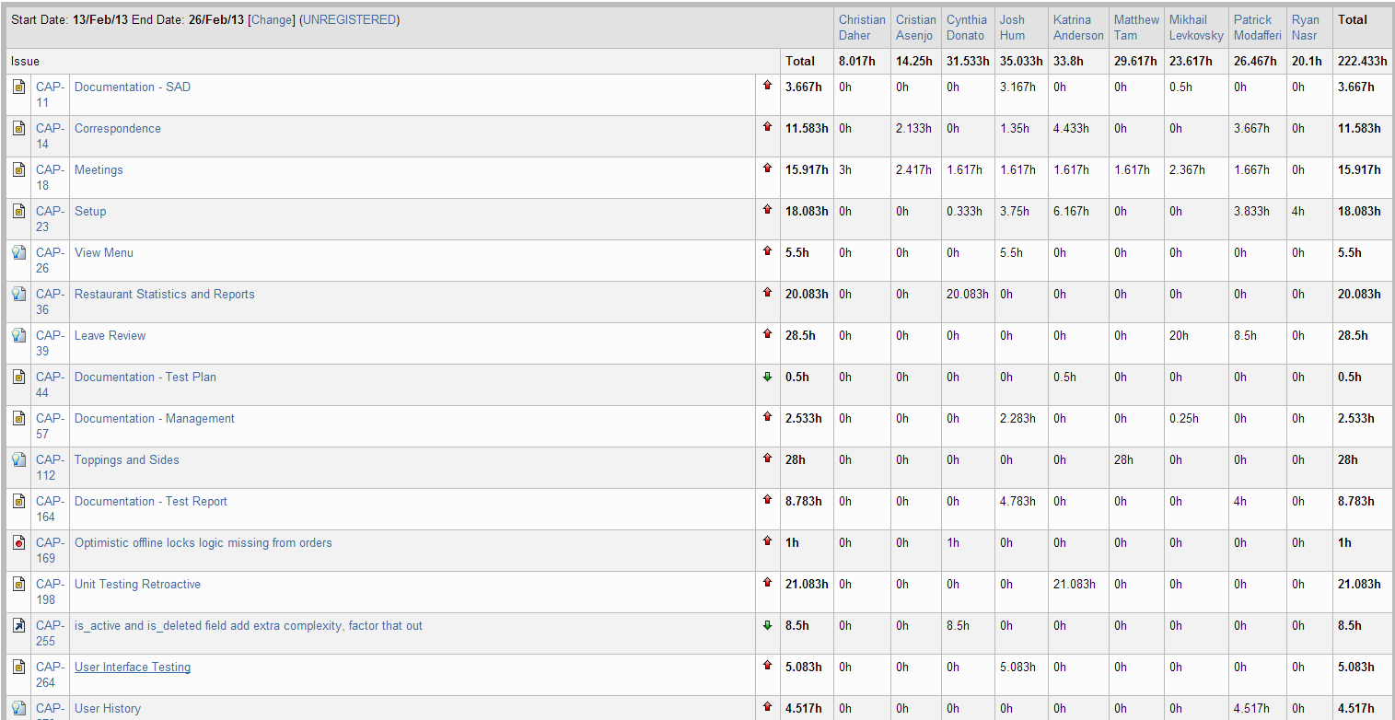
Retrospective – Sprint 8

Slide 5
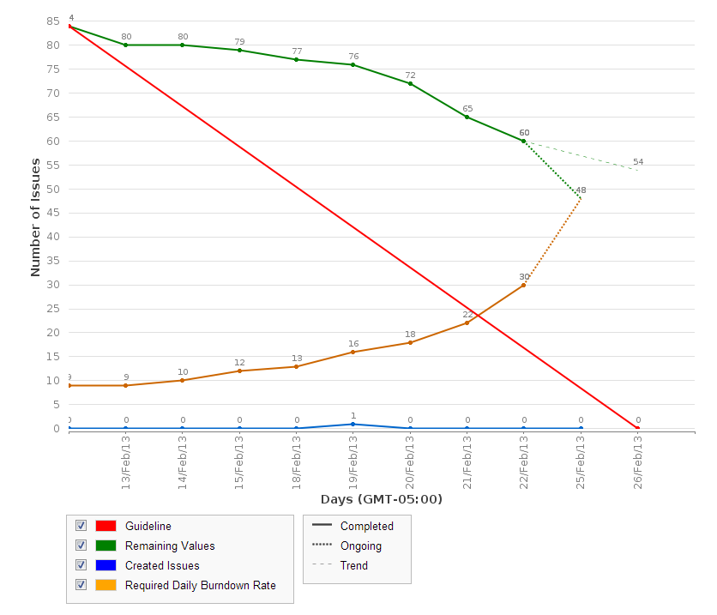
Retrospective – Sprint 8

Slide 6
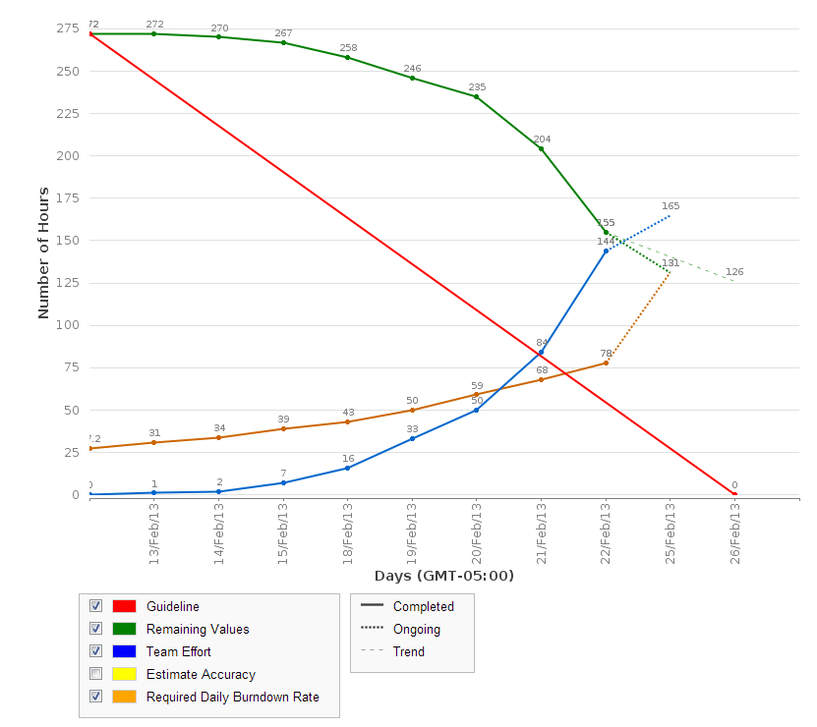
Retrospective – Sprint 8

Slide 7
Scrum update w/ presentation
2 minutes each
7 minutes each w/ presentation
Presentation:
Cynthia
Pat/Mike
Chris
Matt

Slide 8
General Issues
Is tapping into a table supposed to make you enter your password (customer role)
Roles: Customer, Restaurant, Admin, Dev
What are they supposed to be able to do and see?

Slide 9
SAD Updates

Slide 10
Goals
Todo:
DOC UPDATES for Dr. Constantinides
Finish iOS app
UI and Unit Test Reviews
User History?
Finish Sides and Unit Test
Finish waiter stats and Unit Test
Fix flow, ensure all closed stories work the way they should (data validation, etc.)
BUGS!!
See backlog for any new tasks/bugs added

Slide 11
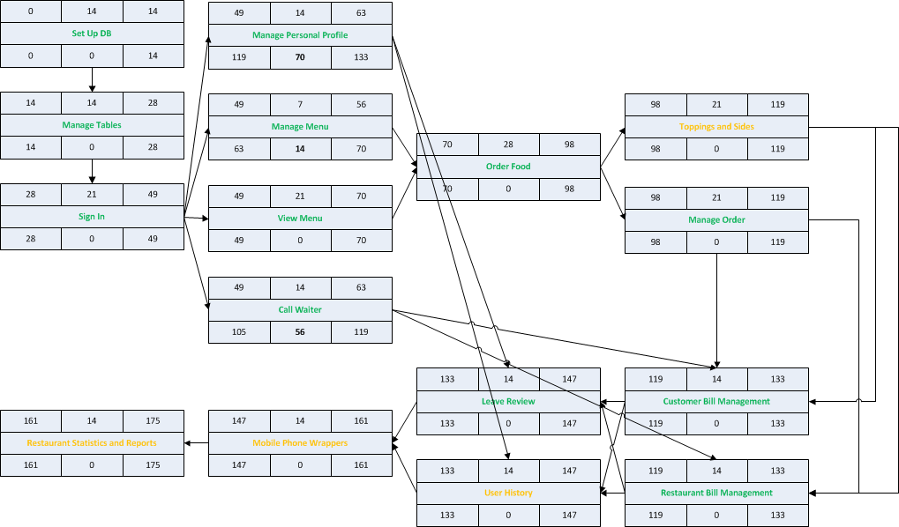
Schedule

Slide 12
Schedule
Sprint 9
DOC UPDATES (Everyone)
iPhone wrapper (Cristian)
QA (Cynthia)
Retroactive unit testing (Katrina)
Finish Sides and Unit Test (Matt)
Bugs (Josh, Ryan, Chris, Cristian, Mike, Pat, Matt)
Reviews and User History & Unit Test (Mike and Pat)
Finish Stats & Reports and Unit Test (Cynthia)
Flow fixer (now part of bugs)

Slide 13
Questions?

